Slide 1
Mental Health Analysis Presentation

Slide 2
Project analysis slide 2
Mental Health Analysis
GENDER
MECHANISM
Suicide Rates
AGE
LATITUDE
GDP

Slide 3
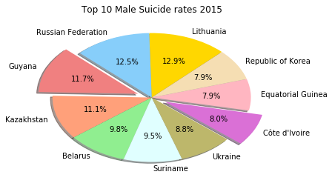
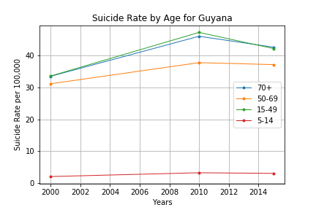
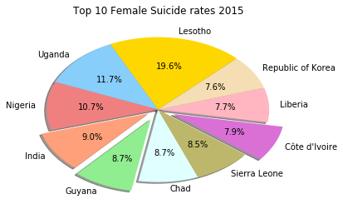
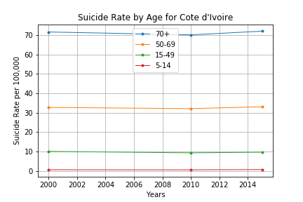
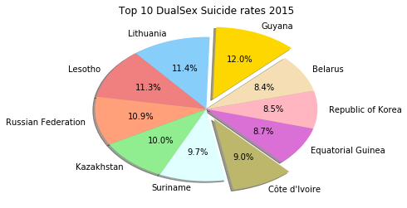
Project analysis slide 5
Suicide Rates Analysis
Year 2015
Guyana
32.4 %
11.7 % Males
8.7 % Females
12.0 % Both Sexes
Age Ranges: 15-49; 70+ years
Cote d’Ivoire
24.9 %
8.0 % Males
7.9 % Females
9.0 % Both Sexes
Age Ranges: 70+ years
Republic of Korea
24 %
7.9 % Males
7.6 % Females
8.5 % Both Sexes
Age Ranges: Data Unavailable

Slide 4
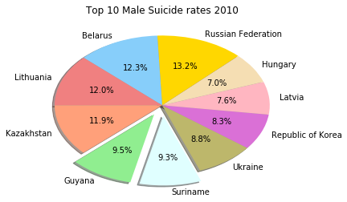
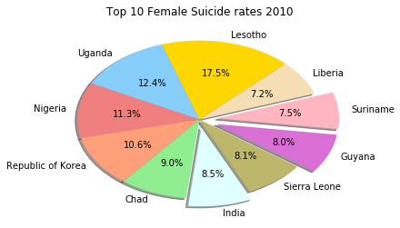
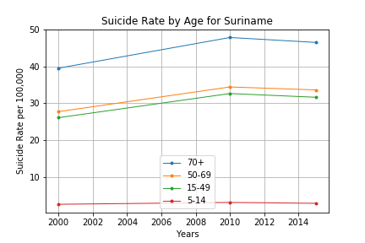
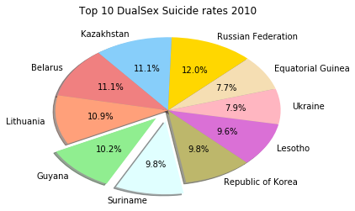
Project analysis slide 5
Suicide Rates Analysis
Year 2010
Guyana
27.7 %
9.5 % Males
8.0 % Females
10.2 % Both Sexes
Age Ranges: 15-49; 70+ years
Suriname
26.6 %
9.3 % Males
7.5 % Females
9.8 % Both Sexes
Age Ranges: 70+ years
Republic of Korea
28.7 %
8.3 % Males
10.6 % Females
9.8 % Both Sexes
Age Ranges: Data Unavailable

Slide 5
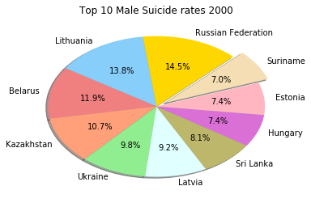
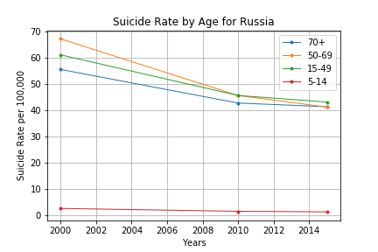
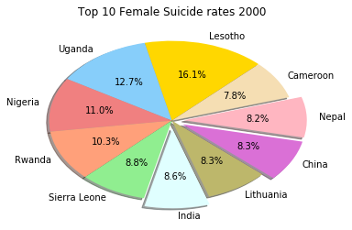
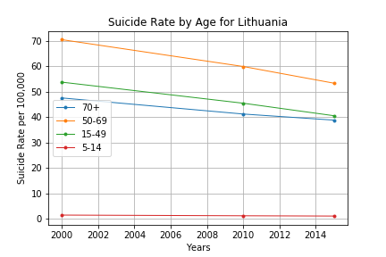
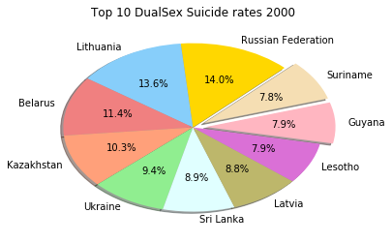
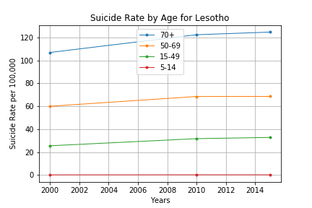
Project analysis slide 5
Suicide Rates Analysis
Year 2000
Russian Federation
28.5 %
14.5 % Males
?? % Females
14.0 % Both Sexes
Age Ranges: 50-69 years
Lithuania
27.4 %
13.8 % Males
?? % Females
13.6 % Both Sexes
Age Ranges: 50-69 years
Lesotho
24 %
?? % Males
16.1 % Females
7.9 % Both Sexes
Age Ranges: 70+ years

Slide 6
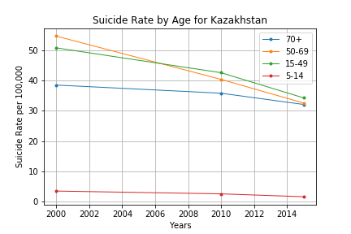
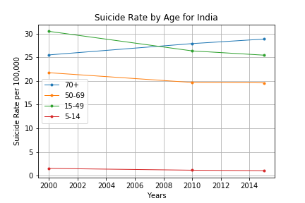
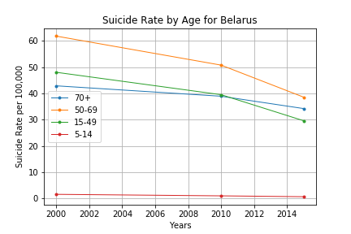
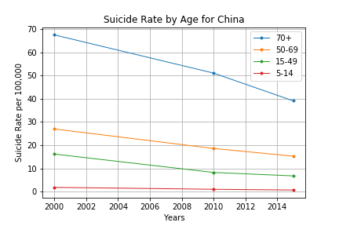
Project analysis slide 5
Suicide Rates Analysis
Years: 2000 - 2015
Kazakhstan & Belarus
Listed among the top 10 countries with Suicide rate estimates in male and both sex gender categories.
India, Lesotho, Uganda, Nigeria, Sierra Leone
Listed among the top 10 countries with Suicide rate estimates in female gender categories.
China
Listed among the top 10 countries with Suicide rate estimates in female gender categories.in year 2000 only.

Slide 7
Thank You

